Slide 1
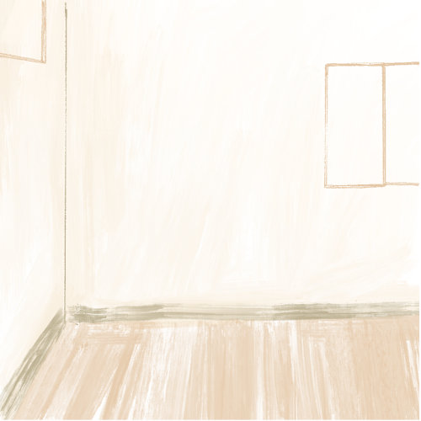




Baby on
the Way
BABY BENNETT
Arriving August 2030

