Slide 1

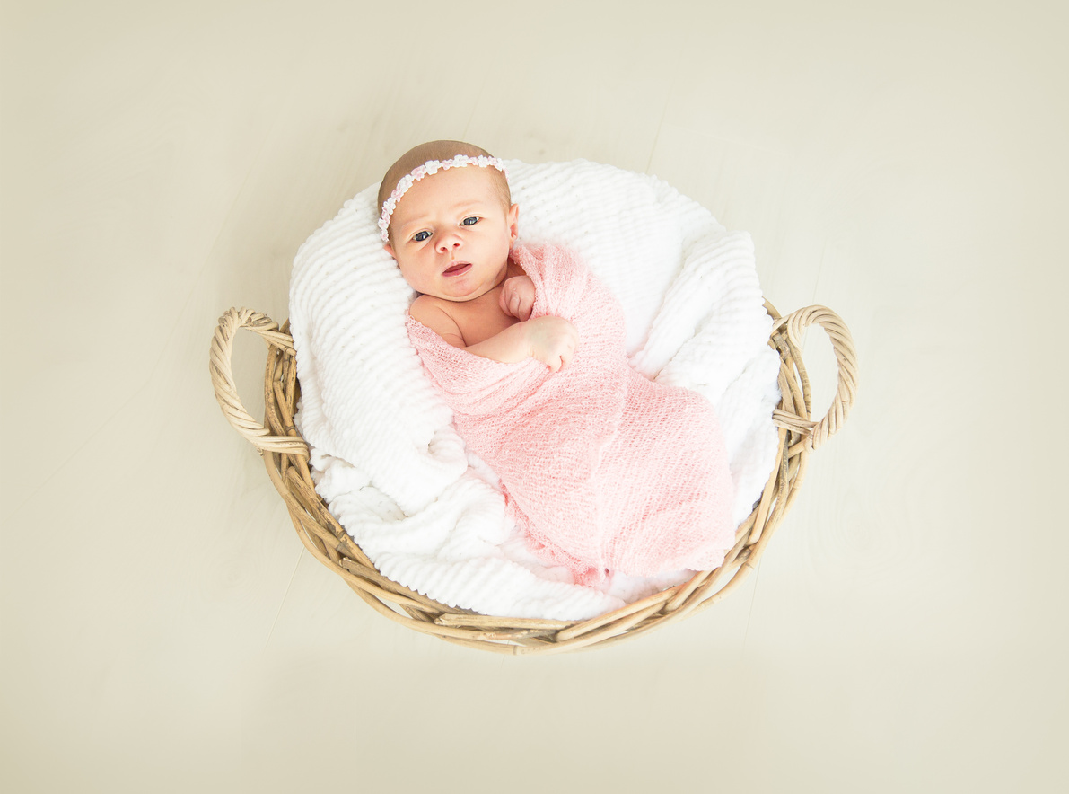

INTRODUCING
Olivia Wilson
Born 20 May 2030
Weight 3.6kg
Length 63cm

