Slide 1



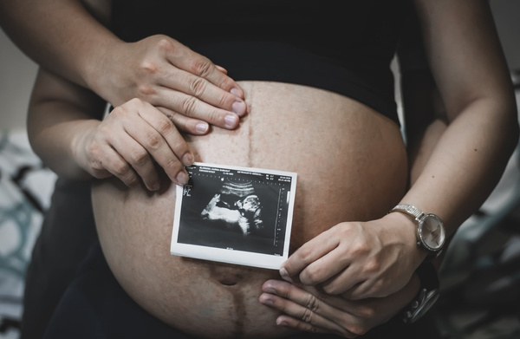
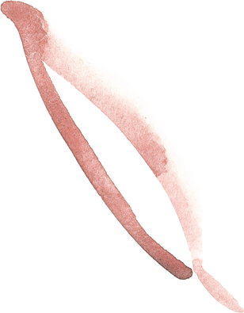




Many good news have come, and here's one more
We're expecting Baby #4!
OUR LITTLE ONE IS DUE IN FIFTEEN WEEKS
We're all thrilled and thankful for your well wishes!

